Slide 1
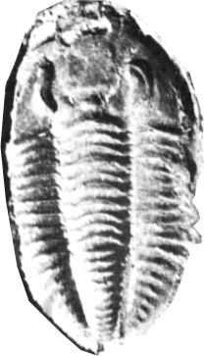
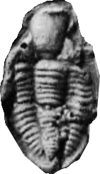
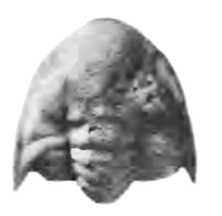
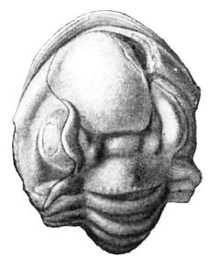
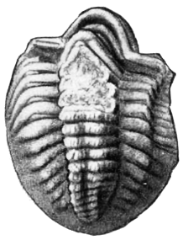
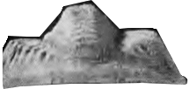
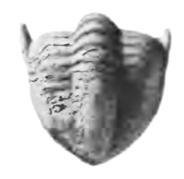
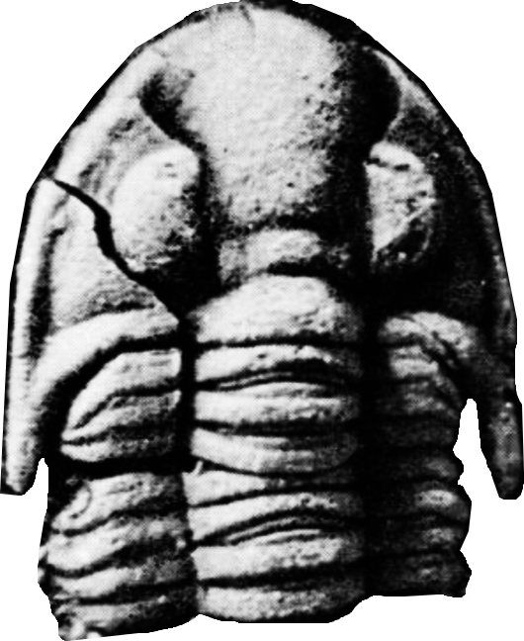
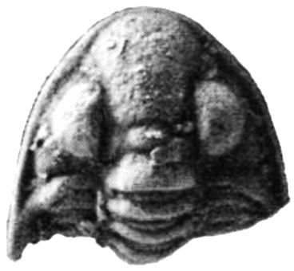
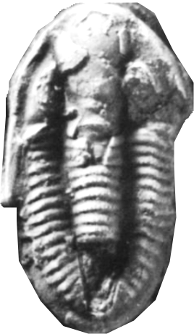
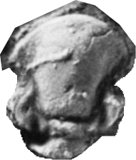
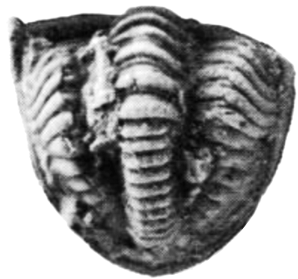
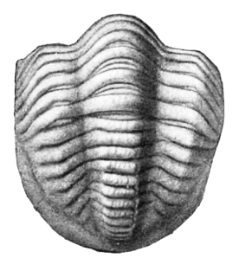
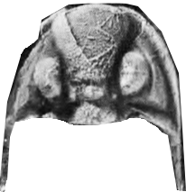
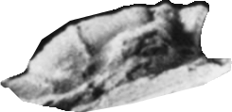
Ditomopyge scitula
Kues 1982, Brezinski 1982 & 1989, Pabian & Fagerstrom 1972, Girty 1915
Ditomopyge decurtata
Mudge & Yochelson 1962, Brezinski 1989, Weller 1944

Slide 2
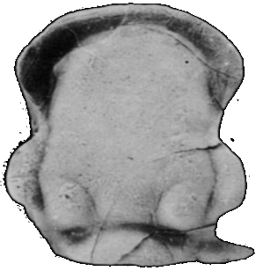
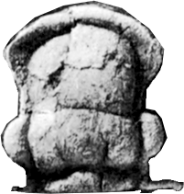
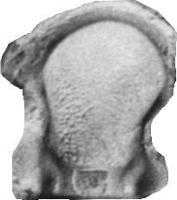
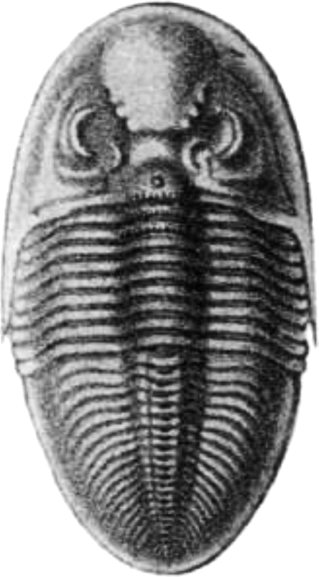
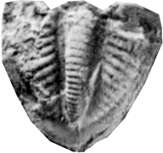
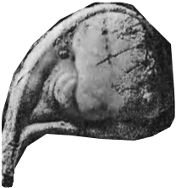
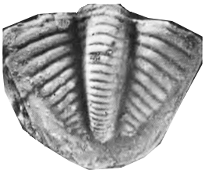
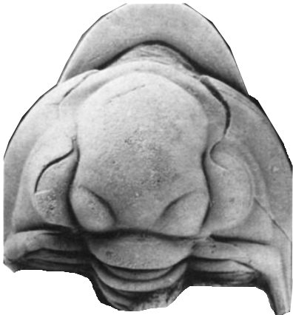
Ameura missouriensis
Brezinski 1989, Pabian & Fagerstrom 1972
Pseudophillipsia sumatrensis
(as an example of this genus)
Weller 1944
Pseudophillipsia sp.
Brezinski 1992, 1999

Slide 3
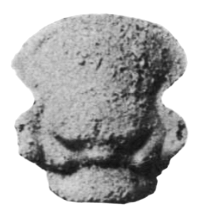
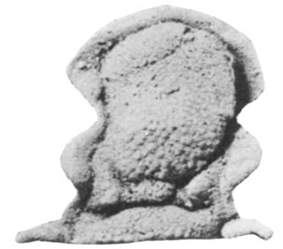
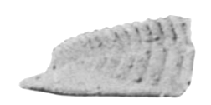
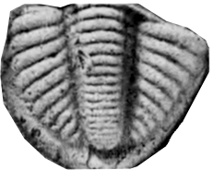
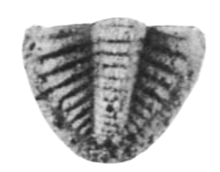
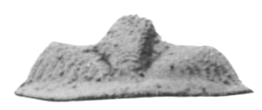
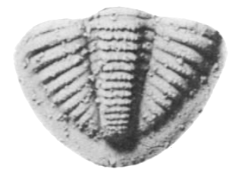
Sevillia trinucleata
Brezinski 1989, 1999, Chamberlain 1969
Sevillia sevillensis
Chamberlain 1969
Brachymetopus kansasensis
Brezinski 1999

Slide 4
Arthropoda – Crustacea - Ostracoda
Paraparchites thomasi
Coryell & Sample 1932
Paraparchites oblongus
Coryell & Sample 1932
Paraparchites latidorsatus
Coryell & Sample 1932
Paraparchites palopintoensis
Coryell & Sample 1932
Paraparchites brazoensis
Coryell & Sample 1932
Paraparchites laduensis
Knight 1928
Paraparchites claytonensis
Knight 1928
Paraparchites wapanuckaensis
Harlton 1928
Paraparchites inornata
Harlton 1927
Paraparchites ornatus
Delo 1930
Paraparchites humerosus
var. texana
Delo 1930
Paraparchites bimammatus
Delo 1930
Waylandella fornicata
Coryell & Billings 1932
Waylandella spinosa
Coryell & Billings 1932
Waylandella waylandica
Coryell & Billings 1932

Slide 5
Healdia spinosa
Meagher 2012
Healdia simplex
Coryell & Booth 1933
Healdia oklahomaensis
Coryell & Sample 1932
Healdia glennensis
Coryell & Sample 1932
Healdia absentia
Coryell & Billings 1932
Healdia formosa
Coryell & Sample 1932, Harlton 1928
Healdia caneyensis
Harlton 1927
Healdia masoni
Coryell & Booth 1933
Healdia colonyi
Coryell & Booth 1933
Healdia quadrispinosa
Coryell & Billings 1932
Healdia compressa
Coryell & Billings 1932
Healdia cuneata
Coryell & Sample 1932
Healdia miranda
Coryell & Billings 1932
Healdia ackersi
Delo 1930
Healdia concinna
Delo 1930
Healdia cincta
Coryell & Billings 1932
Healdia longa
Coryell & Sample 1932
Healdia alba
Coryell & Sample 1932
Healdia subangularis
Delo 1930
Healdia obsolens
Delo 1930
Healdia lentiformis
Delo 1930
Healdia ciscoensis
Harlton 1927
Healdia boggyensis
Harlton 1927
Healdia marginata
Harlton 1928
Healdia torquata
Harlton 1928
Healdia squamosa
Harlton 1928
Healdia overbrookensis
Harlton 1927

Slide 6
Amphissites centronotus
Coryell & Sample 1932
Amphissites dattonensis
Coryell & Sample 1932
Amphissites pinguis
Coryell & Sample 1932
Amphissites girtyi
Coryell & Sample 1932
Amphissites irregularis
Coryell & Sample 1932, Meagher 2012
Amphyssites centronotus
Coryell & Booth 1933
Amphissites ciscoensis
Harlton 1928
Amphissites allerismoides
Knight 1928
Amphissites roundyi
Knight 1928
Amphissites simplicissimus
Coryell & Billings 1932
Girtyites spinosus
Coryell & Booth 1933
Kirkbyella typa
Coryell & Booth 1933
Moorites truncatus
Coryell & Billings 1932
Moorites minutus
Meagher 2012, Coryell & Billings 1932
Moorites minutus
Coryell & Sample 1932
Moorites hewetti
Coryell & Sample 1932
Coryell & Billings 1932
Cornigella longispina
Coryell & Sample 1932
Cornigella minuta
Coryell & Sample 1932
Moorites parallela
Coryell & Sample 1932

Slide 7
Hollinella kellettae
Coryell & Booth 1933
Hollinella bulbosa
Coryell & Sample 1932
Hollinella harltoni
Coryell & Sample 1932
Hollinella digitata
Coryell & Sample 1932
Ulrichia montosa
Knight 1928
Hollinella australis
Delo 1930
Hollinella herrickiana
Delo 1930
Hollinella occidentalis
Delo 1930
Hollina radlerae
Harlton 1928
Hollina buehleri
Knight 1928
Hollina fortscottensis
Knight 1928
Hollina grahamensis
Harlton 1927
Hollina granifera
Harlton 1927
Hollina tricollina
Harlton 1927
Hollina bassleri
Knight 1928
Hollina ulrichi
Knight 1928

Slide 8
Jonesina oklahomaensis
Harlton 1928
Jonesina craterigera
Harlton 1927
Jonesina arcuata
Harlton 1927, Knight 1928
Jonesina bradyana
Harlton 1927
Jonesina gregaria
Harlton 1928
Jonesina grahamensis
Coryell & Booth 1933
Jonesina subquadrata
Delo 1930
Glyptopleura costata
Harlton 1927
Glyptopleura spinosa
Delo 1930
Glyptopleura emarginata
Delo 1930
Jonesina acuneata
Coryell & Sample 1932
Jonesina prolata
Delo 1930
Jonesina texana
Coryell & Sample 1932
Jonesina ampla
Coryell & Sample 1932
Kirkbyina laevis
Coryell & Sample 1932
Dilobella texana
Coryell & Booth 1933
Sulcella warthini
Coryell & Sample 1932
Sulcella sulcata
Coryell & Sample 1932
Hollites papillosus
Coryell & Sample 1932

Slide 9
Artifactella tomahawki
Coryell & Booth 1933
Cavellina subpulchella
Coryell & Booth 1933
Waylandella cuyleri
Coryell & Booth 1933
Birsallella simplex
Coryell & Booth 1933
Cythereis (?) ardmorensis
Harlton 1927
Seminolites compressus
Coryell & Billings 1932
Seminolites elongatus
Coryell & Billings 1932
Seminolites truncatus
Coryell & Billings 1932
Seminolites ovatus
Delo 1930
Moorea elongata
Coryell & Sample 1932
Kirkbya clarocarinata
Coryell & Billings 1932
Kirkbya clarocarinata
Knight 1928
Kirkbya voluta
Knight 1928
Kirkbya scaphula
Knight 1928
Kirkbya laciniata
Knight 1928
Burlella pecanata
Coryell & Booth 1933

Slide 10
Bairdia auricula
Coryell & Sample 1932
Bairdia rogatzi
Coryell & Sample 1932
Bairdia ciscoensis
Coryell & Sample 1932
Bairdia oklahomaensis
Coryell & Sample 1932
Bairdia summa
Coryell & Billings 1932
Bairdia subvexa
Coryell & Billings 1932
Bairdia pediformis
Coryell & Booth 1933
Bairdia moorei
Coryell & Billings 1932
Bairdia pompilioides
Harlton 1928
Bairdia hispida
Coryell & Sample 1932
Bairdia seminalis
Coryell & Sample 1932
Bairdia angulata
Coryell & Sample 1932
Bairdia pinnula
Coryell & Booth 1933
Bairdia hurwitzi
Coryell & Booth 1933
Bairdia acetalata
Coryell & Booth 1933
Bairdia scholli
Coryell & Booth 1933
Bairdia nitida
Harlton 1928
Bairdia samplei
Coryell & Booth 1933
Bairdia blakei
Meagher 2012
Bairdia grahamensis
Harlton 1928
Bairdia glennensis
Harlton 1927
Bairdia texana
Harlton 1927
Bairdia subelongata
Harlton 1927
Bairdia hoxbarensis
Harlton 1927

Slide 11
Bythocypris parallela
Coryell & Sample 1932
Bythocypris centralis
Coryell & Sample 1932
Bythocypris texensis
Coryell & Sample 1932
Bythocypris semicirculus
Coryell & Sample 1932
Bythocypris palopintoensis
Coryell & Sample 1932
Cytherella incurvescens
Harlton 1927
Bythocypris tomlinsoni
Coryell & Billings 1932
Bythocypris scapha
Coryell & Billings 1932
Bythocypris procera
Coryell & Billings 1932
Bythocypris pediformis
Coryell & Sample 1932
Cytherella gloria
Coryell & Sample 1932
Cytherella ovoidiformis
Harlton 1928
Cytherella calcar
Harlton 1928
Cytherella footi
Coryell & Booth 1933
Cytherella watkinsi
Coryell & Sample 1932
Cytherella proxima
Coryell & Sample 1932
Cytherella tongia
Coryell & Sample 1932
Cytherella wewokana
Coryell & Sample 1932
Cytherella constricta
Delo 1930
Cavellina jejuna
Coryell & Sample 1932
Cavellina lintris
Coryell & Sample 1932
Cavellina pulchella
Coryell 1928, Coryell & Sample 1932
Cavellina nebrascensis
Meagher 2012
Cavellina reversa
Coryell 1928, Coryell & Sample 1932

Slide 12
Bairdia pecosensis
Delo 1930
Bairdia meandrensis
Delo 1930
Bairdia crassa
Delo 1930
Bairdia seligi
Delo 1930
Bairdia irionensis
Delo 1930
Bairdia shideleri
Delo 1930
Acratia typica
Delo 1930
Acratia magna
Delo 1930
Bairdianella elegans
Delo 1930
Macrocypris menardensis
Delo 1930
Kellettella naviculata
Delo 1930
Silenites silenus
Coryell & Booth 1933
Argilloecia regularis
Delo 1930
Aechmina (?) gibberosa
Knight 1928

